Slide 1
Shell Bootcamp 2024 3 Reflections for Week 4
Kabir Dhruw
Date : 19-Sept-2024

Slide 2

About Me
Chase excellence, Not perfection.

Slide 3

My learnings from this week!

Slide 4
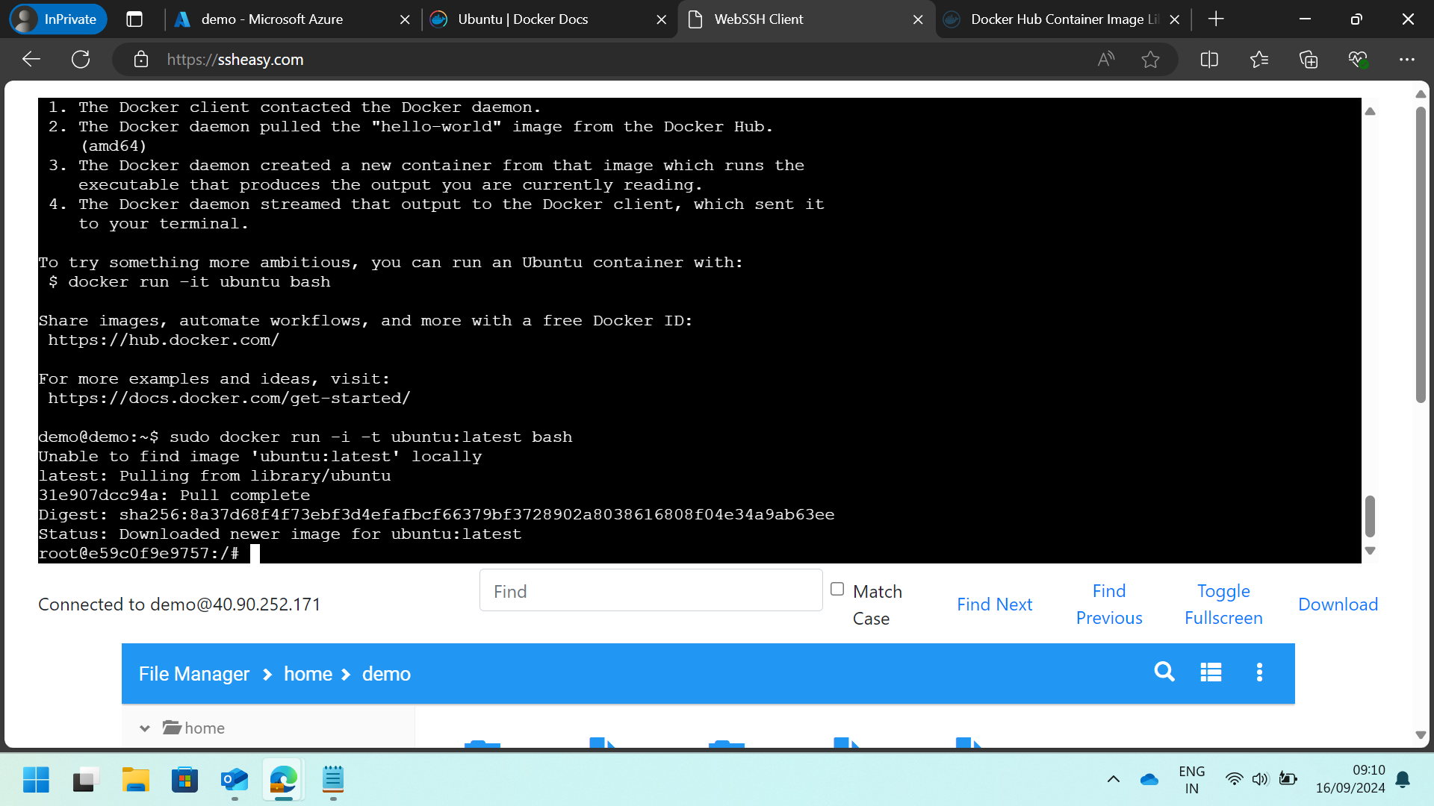
Learning 1 |
During the training, I gained a comprehensive understanding of Docker, including its architecture and core components like Docker Engine, Docker Hub, and Docker Compose.
I learned how to create, manage, and deploy containers, and the benefits of containerization over traditional virtual machines.

Slide 5
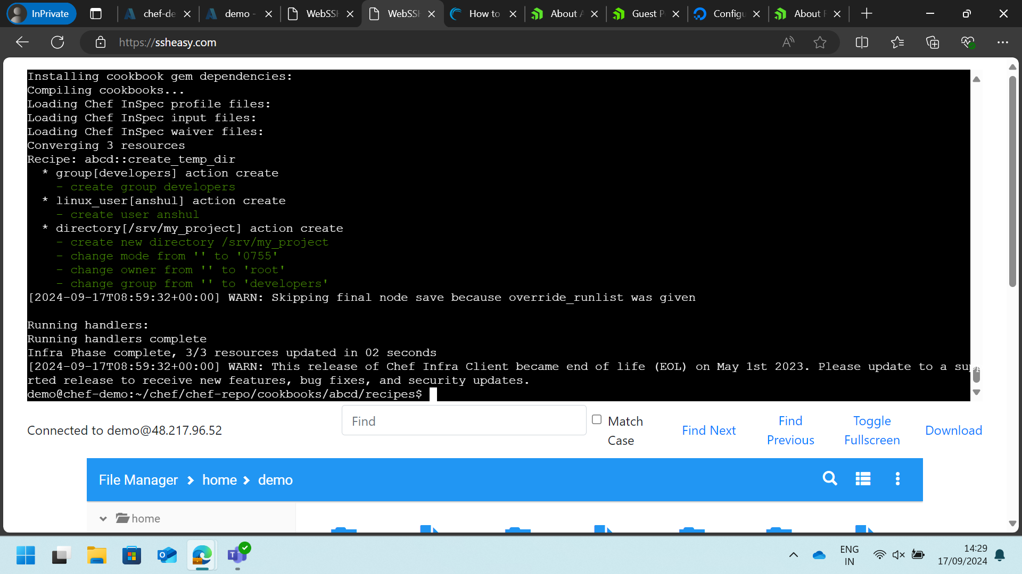
Learning 2 |
I learned how to deploy, manage, and scale containerized applications using Kubernetes.
The training also covered essential concepts like services, deployments, and stateful sets, as well as advanced topics like networking, storage, and security within Kubernetes environments.

Slide 6
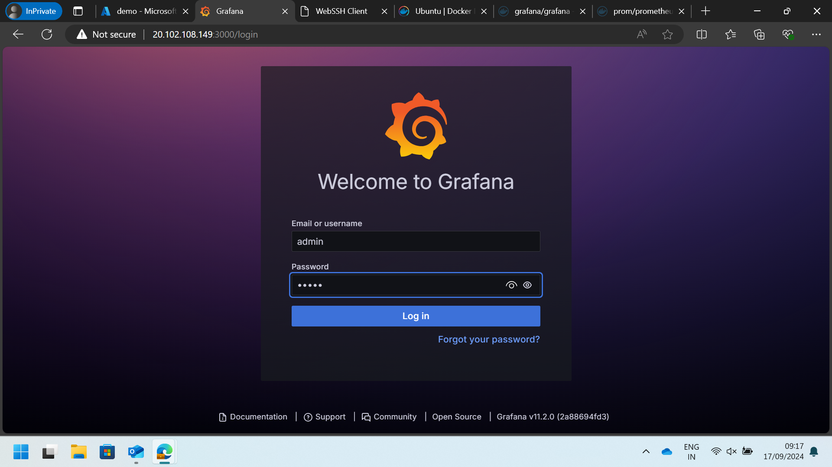
Learning 3 |
I explored how to set up Prometheus, configure it to scrape metrics.
Grafana, on the other hand, is a visualization tool that integrates seamlessly with Prometheus to create interactive and insightful dashboards.
I learned how to build and customize dashboards in Grafana to visualize the metrics collected by Prometheus.

Slide 7

Relevance of learnings for my organization

Slide 8
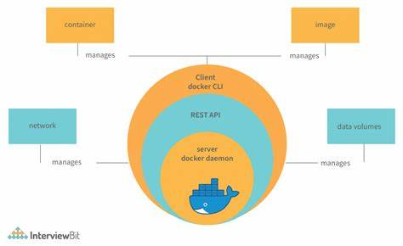
Learning 1 | Relevance for Shell
Implementing Docker in our organization can significantly enhance efficiency by streamlining the development and deployment processes. Docker ensures consistency across different environments, reducing the common “it works on my machine” issues.

Slide 9
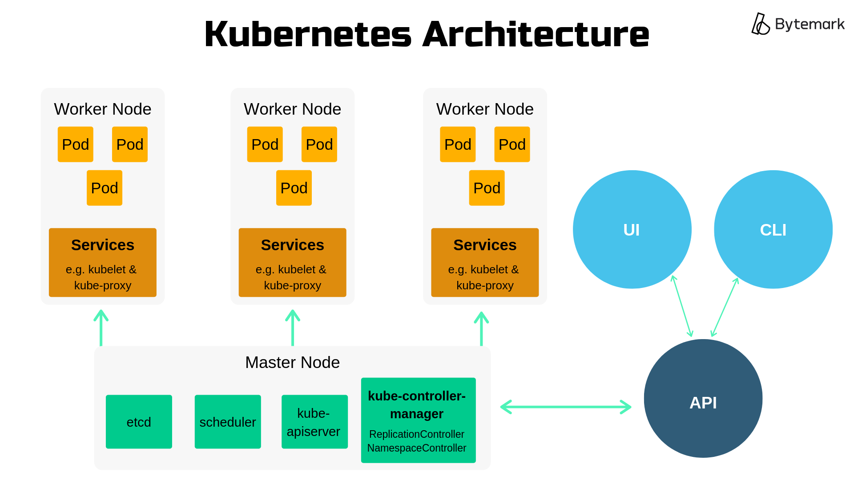
Learning 2 | Relevance for Shell
Kubernetes can greatly benefit our organization by providing robust orchestration for our containerized applications. It ensures high availability and scalability, allowing us to handle varying workloads efficiently. Kubernetes also offers automated rollouts and rollbacks, which can enhance our deployment processes and reduce downtime.

Slide 10
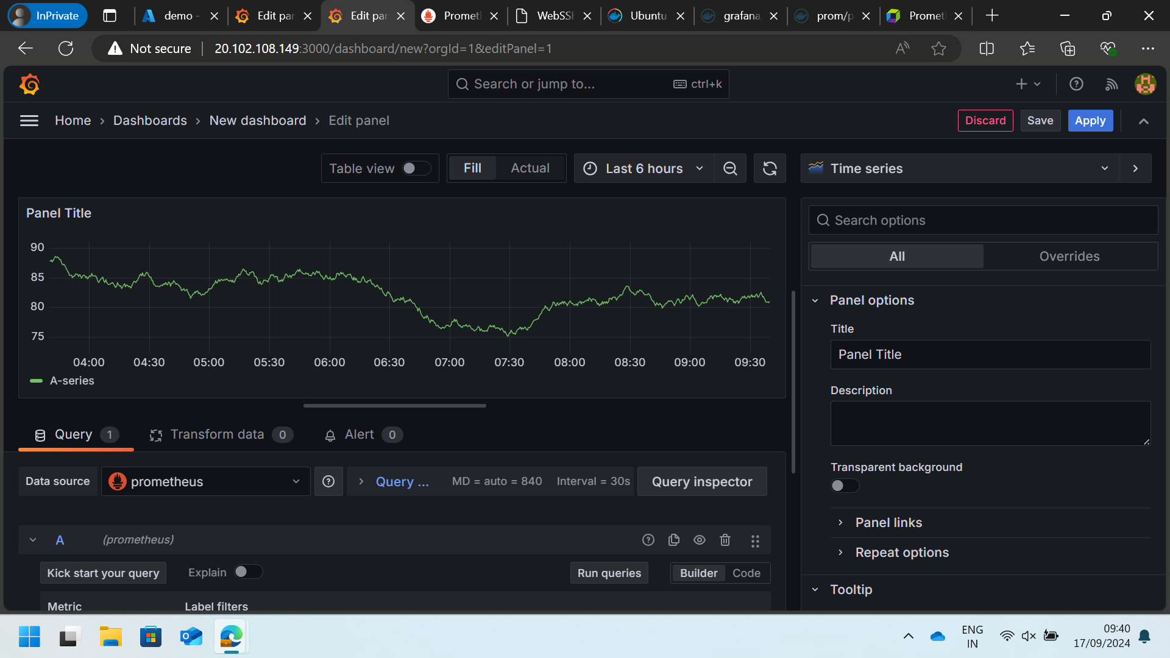
Learning 3 | Relevance for Shell
Implementing Prometheus and Grafana in our organization can significantly enhance our monitoring and observability capabilities. Prometheus allows us to collect detailed metrics from our systems, providing valuable insights into performance and resource utilization.

Slide 11

Challenges in implementing learning

Slide 12
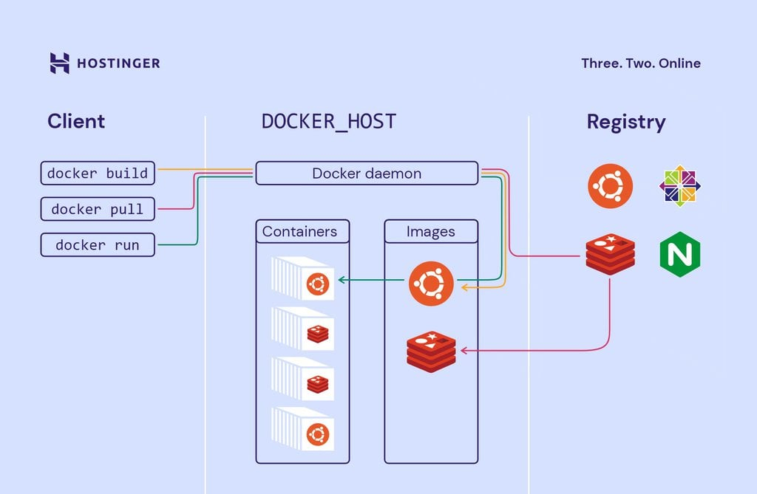
Challenge faced while implementing Learning 1
Debugging containerized applications, especially with network configurations and data persistence, proved to be tricky. Additionally, ensuring the security of Docker containers and images required learning best practices, and managing resources effectively within containers was essential to avoid performance bottlenecks.

Slide 13
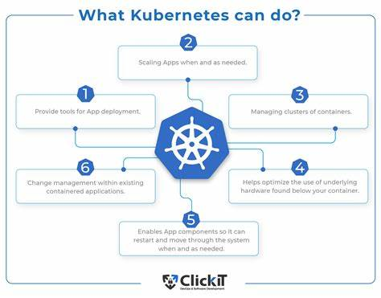
Challenge faced while implementing Learning 2
Managing and configuring clusters, especially in a production environment, required a deep understanding of networking and storage solutions. Debugging issues within a Kubernetes cluster, such as pod failures and network connectivity problems, proved to be intricate.

Slide 14
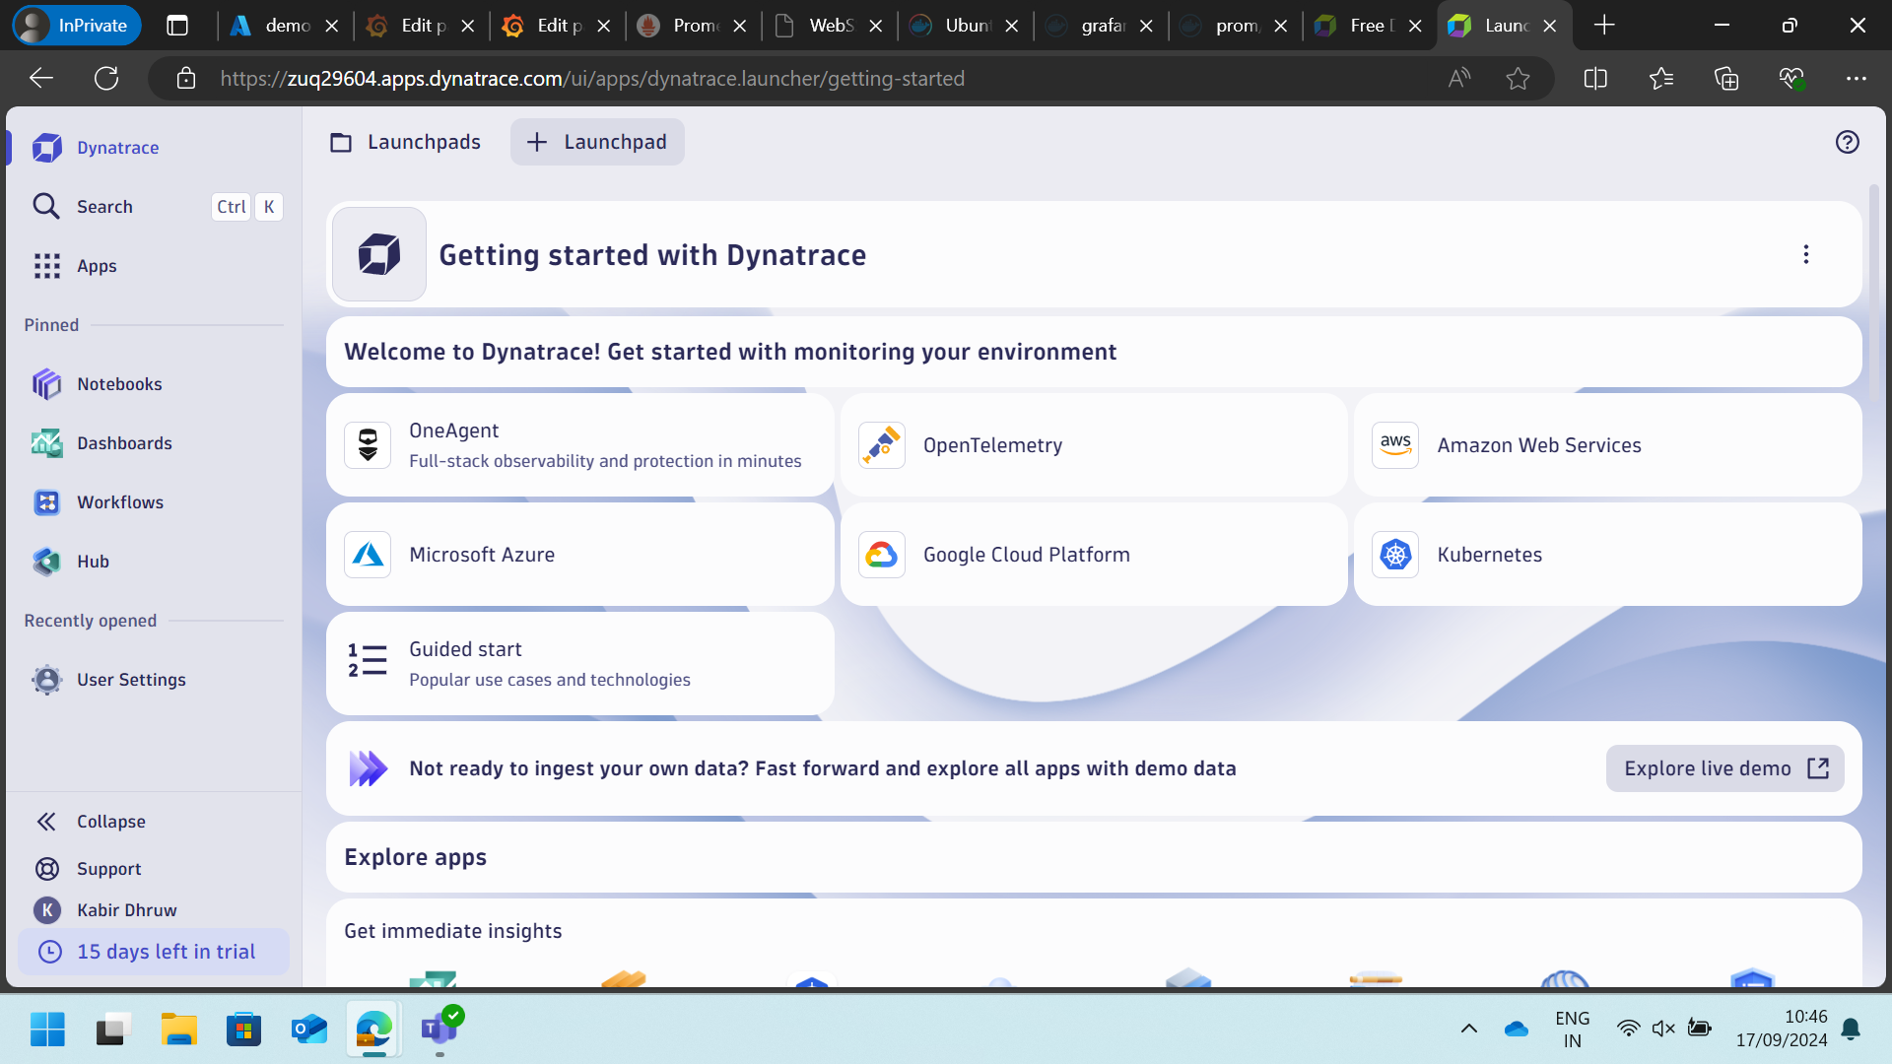
Challenge faced while implementing Learning 3
Creating effective and meaningful dashboards in Grafana involved understanding the various visualization options and how to best represent the collected data. Ensuring the security and scalability of the monitoring setup also posed challenges, requiring careful planning and implementation of best practices.

Slide 15

Action Plan

Slide 16
My Action Plan for this Week
Actions
Timeline
Status
Spend some more time with different types of docker containerization projects and different types of k8 architecture.
This task need constant practice
Already started learning

Slide 17

Learning is also Fun!

Slide 18
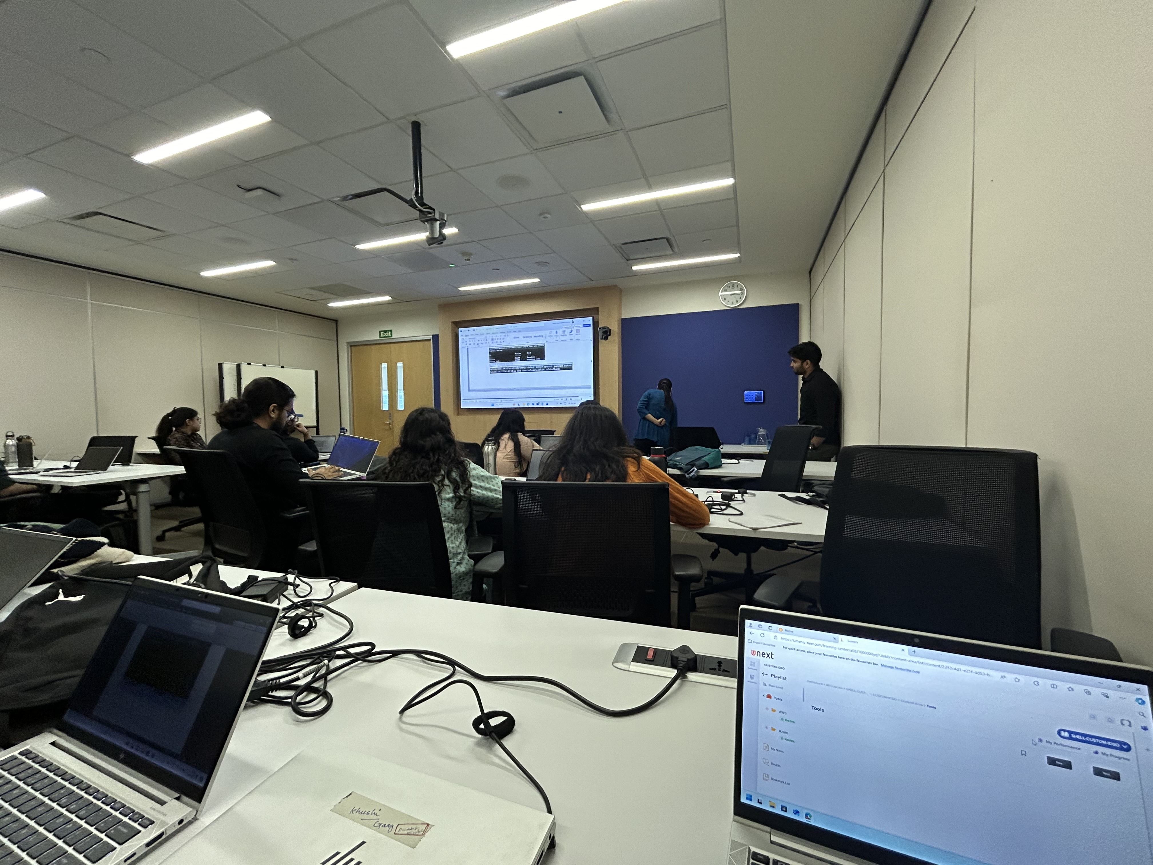
Learning is also Fun!
The frequency of hands-on is increased from the previous classes, I feel more motivated to attend the sessions now.

Slide 19

Summary
I learned about Docker for containerization, Kubernetes for orchestration, and Prometheus with Grafana for monitoring.
These tools enhance efficiency by streamlining development and deployment, improve scalability through robust orchestration, and boost observability with detailed metrics and insightful dashboards.
Despite the challenges of complex configurations and ensuring security, they offer significant benefits, making IT infrastructure more resilient and responsive.

Slide 20
Thank You

